Slide 1
GR740 User Day
AIR Hypervisor using GR740 and N2X

Slide 2
CONTENTS
AIR Overview
MULTIMA
HAIR
NGT-ATB
VERICOCOS
ESROCOS
COMRADE
MORA-TSP
Page 2

Slide 3

AIR
Overview

Slide 4

AIR overview
What is AIR
REAL-TIME HYPERVISOR
COMPLIANT WITH ARINC 653 and IMA-SP
AIR is a type-1 hypervisor that guarantees TSP in the target hardware
Allows multiple avionics applications with different criticalities to run independently in the same hardware resource
Development
Integration
Prototyping
Page 4

Slide 5
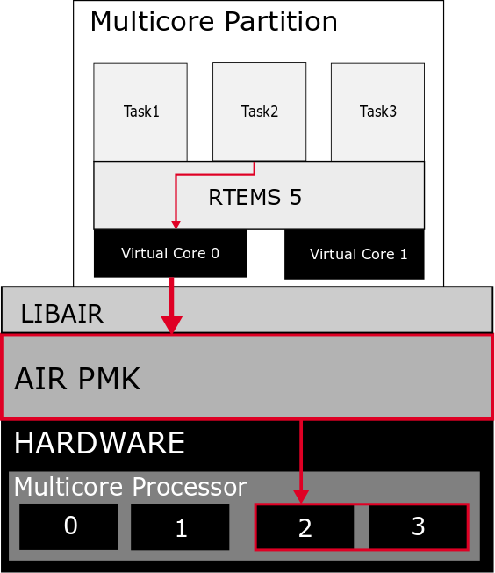

Supported RTOS
RTEMS
AIR supports paravirtualized RTOS versions for SPARC:
RTEMS version 4.8i (a space tailored version of RTEMS 4.8 by Edisoft^{[1]})
RTEMS version 5
  SMP
  Flexibility to move tasks across different schedulers and reassign cores to schedulers
[1] - “RTEMS by Edisoft” Edisoft - Defense & Aerospace, www.edisoft.pt/product-list/rtems
Page 5

Slide 6
GR740 WITH
MULTIMA

Slide 7
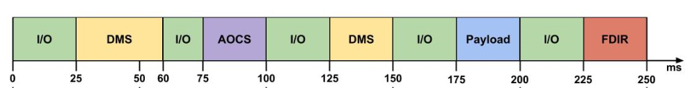
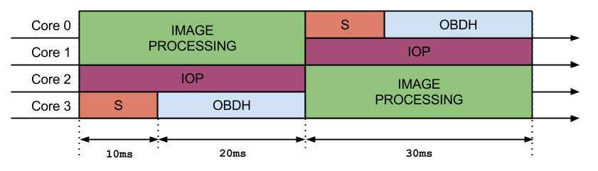
Objectives
TSP in Multicore
There is new processor and development board is in town. NGMP – N2X
It is multicore with 4 processors.
AIR goes multicore and let’s benchmark it!
Page 7

Slide 8
MULTIMA 2013
BENCHMARK RESULTS
Amdahl law happened as expected!
AIR presence overhead grows
inversely with window size
Window Slot (s) | Execution Time (s) | Iterations per second | CoreMark^{[2]} | Performance Loss
NO AIR | 12.070 | 166 | 1.105 | -
1.000 | 12.240 | 163 | 1.089 | 1.38%
0.500 | 12.240 | 163 | 1.088 | 1.39%
0.010 | 12.450 | 161 | 1.074 | 2.77%
0.001 | 12.669 | 157 | 1.050 | 4.88%
[2] - “CoreMark® An EEMBC Benchmark”, EEMBC, https://www.eembc.org/coremark/
Page 8

Slide 9
GR740 WITH
HAIR

Slide 10
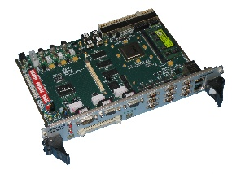
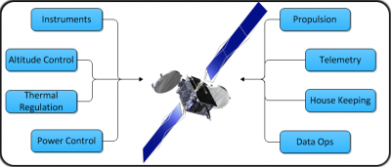



EMULATE GR740
OBJECTIVES
Same Functional behaviour of the OBSW
Same time profile of execution OBSW
Same TSIM like interface to user
Same impact of SW running on other cores/partitions
OBSW
OBSW

Slide 11
HAIR Emulation – Binary Timing Mode
EMULATOR DESCRIPTION
Execution
Profile DB
HAIR Configuration
Script File
Hairdresser
OBSW Source
AIR Config.
(XML)

Slide 12
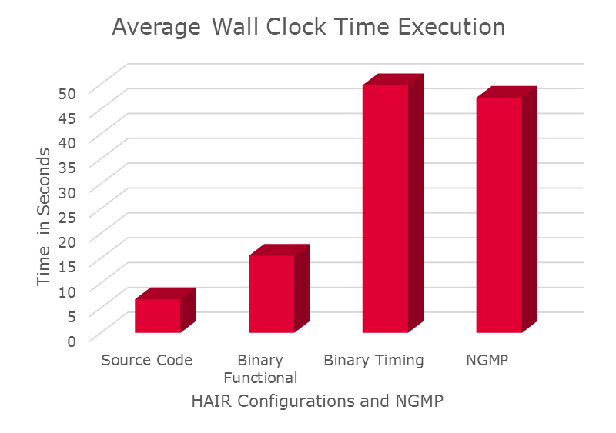
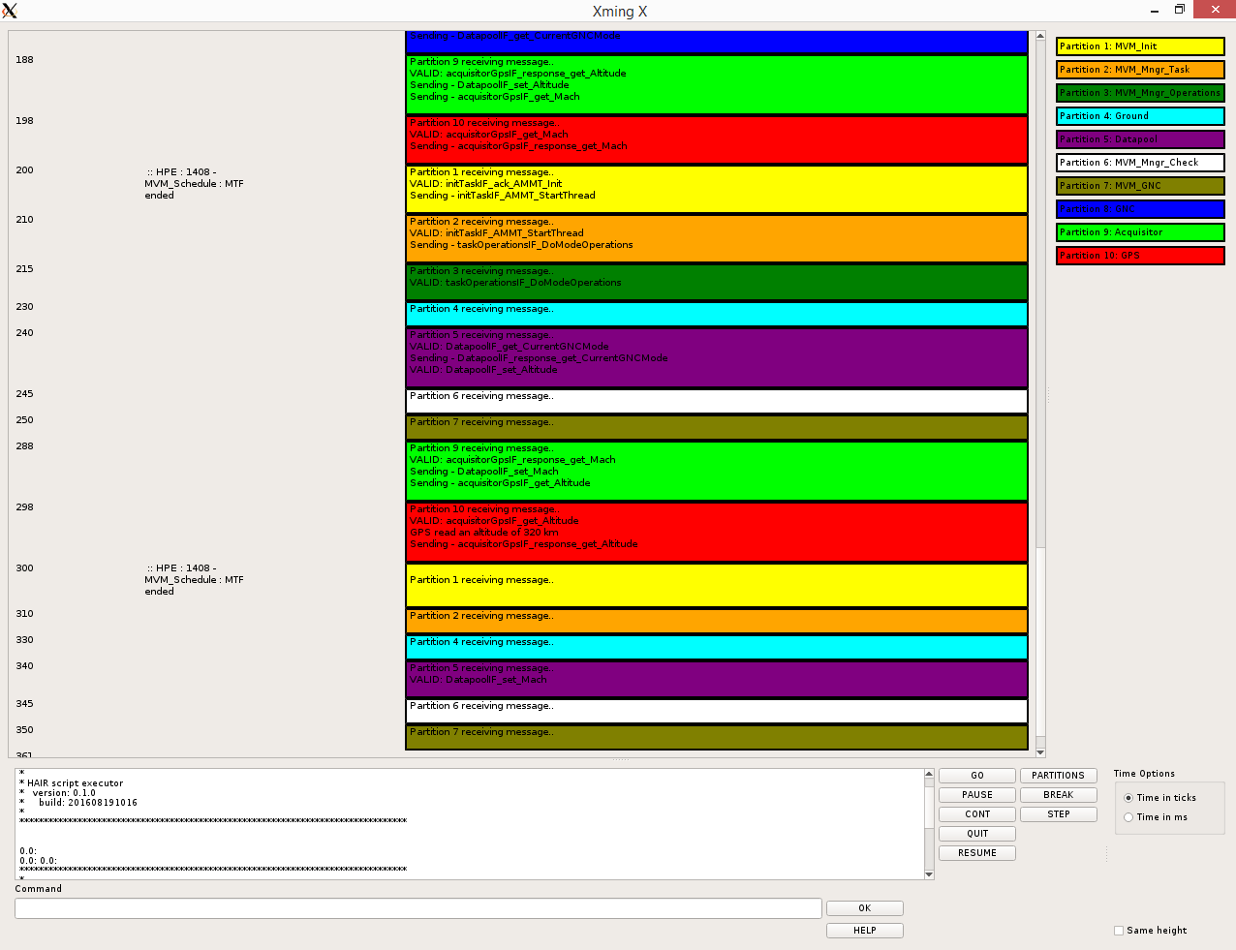
Accurate Timing
RESULTS

Slide 13
GR740 WITH
NGT-ATB

Slide 14
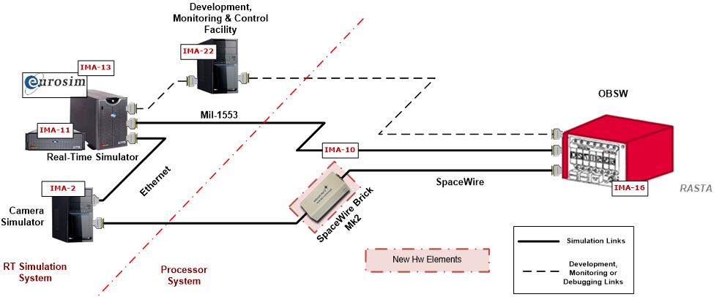

ATB for Next Generation Launcher
OBJECTIVES
Implementation of a ADR use case running at ESTEC ATB with GR740

Slide 15
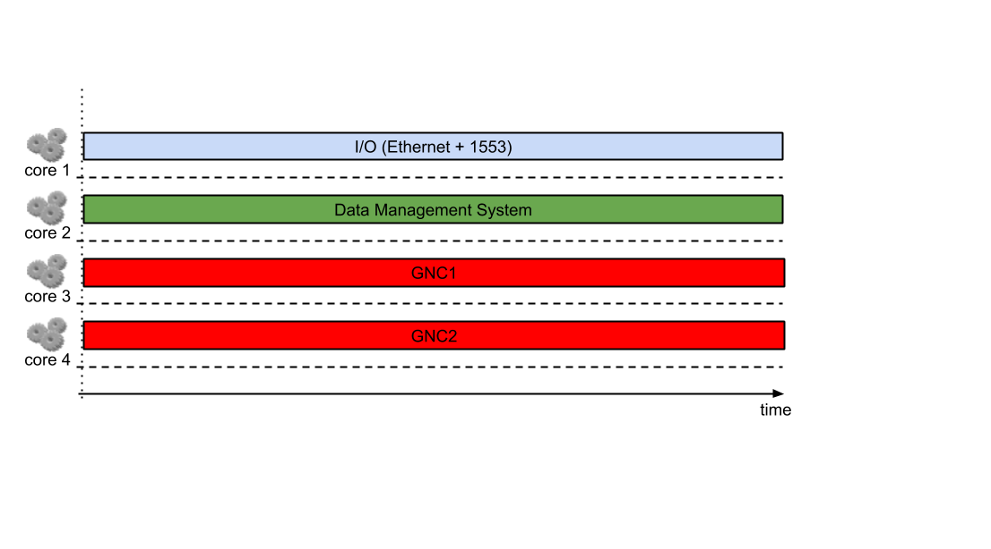
Active Debris Removal Use
USE CASE
GR740 provide enough computation power for a complex GNC algorithm

Slide 16
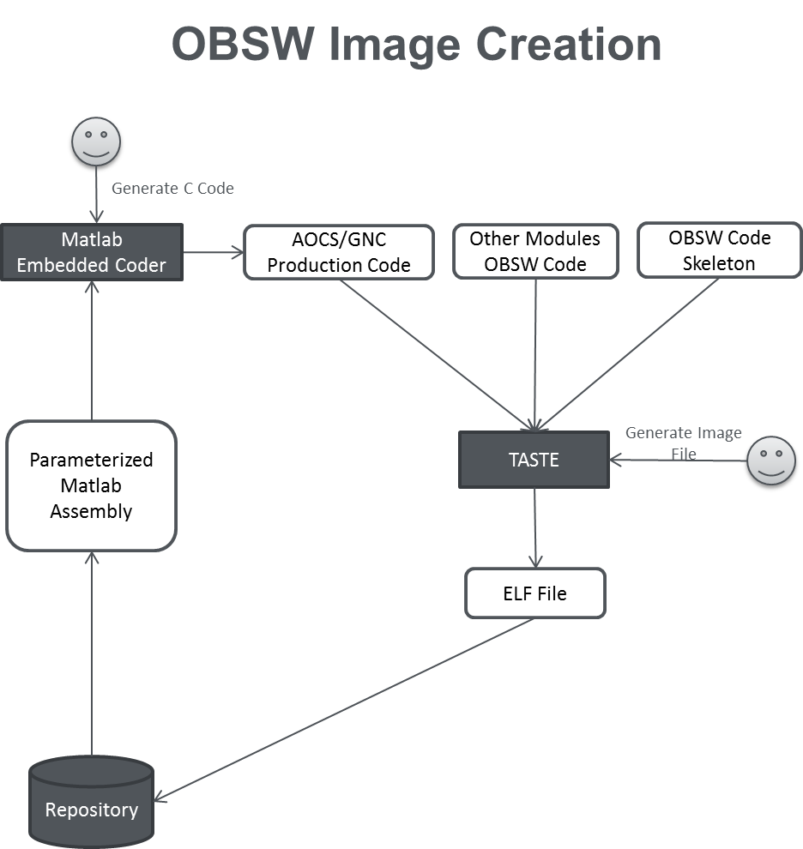
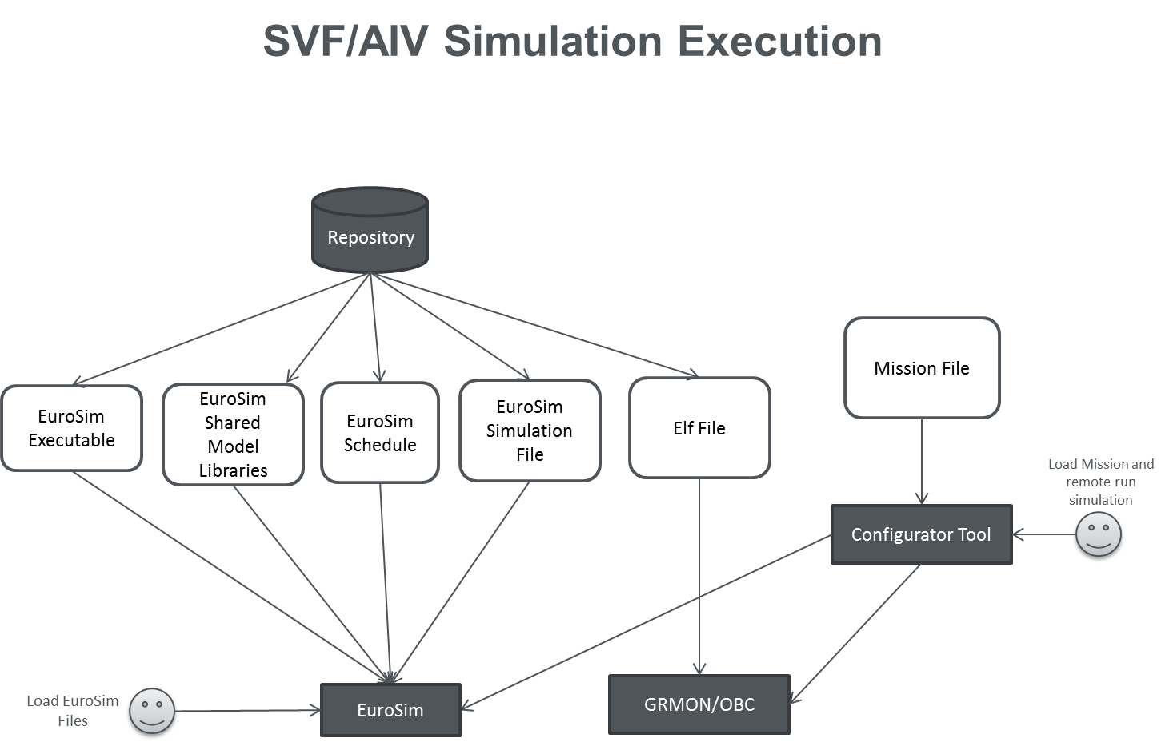
Integration with all Testbed tools
RESULTS
Binary image created with Matlab and TASTE.
Execution in full SVF/AIV environment.

Slide 17
GR740 WITH
VERI
COCOS

Slide 18
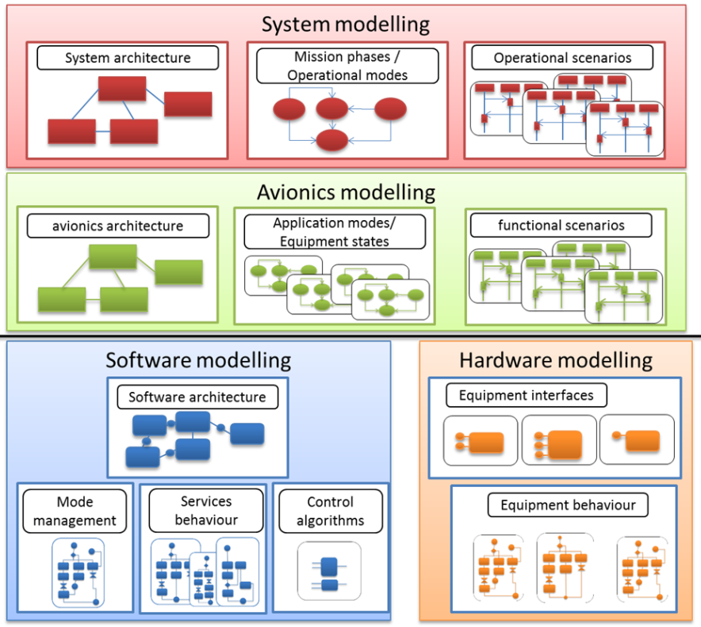


VERICOCOS Toolchain
OBJECTIVES
OpenGeode (SDL)
MSC Editor
AAML Editor
OSRA Editor
SOIS EDS Tool
OpenGeode (SDL)
SCM
Matlab / Simulink

Slide 19
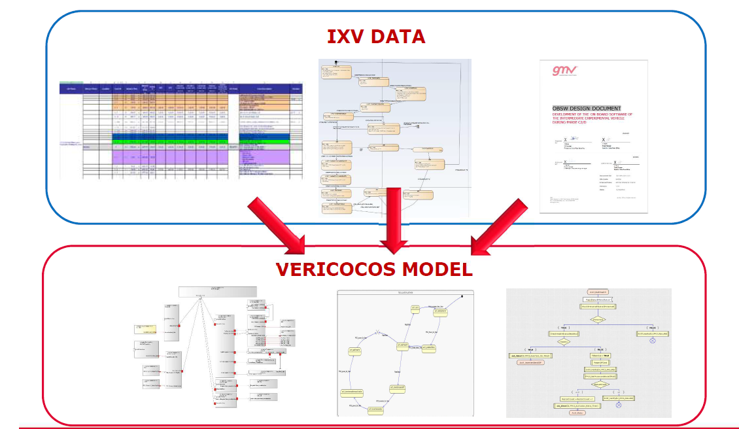
IXV Use Case
MODELLING DESCRIPTION

Slide 20
Migration to GR740 and HAIR
Thesis
From TASTE generated source code skeletons an analysis was made of required change to executing in multi-core and TSP.
Demonstrated running in N2X and HAIR
7 partitions evenly distributed in time and in the four processor cores.

Slide 21
GR740 WITH
ESROCOS

Slide 22












EUROPEAN SPACE ROBOTICS CONTROL AND OPERATING SYSTEM (ESROCOS)
COMPET-04-2016. Proposal 730080

Slide 23


ESROCOS Toolchain
OBJECTIVES
Robotics Modelling
Real-Time SW Modelling and Analysis
State-machines
for FDIR
ASN-1
Data types
Basic robotics libraries
Logging
PUS Services (TM/TC)
Third-party Open Source Robotics SW, Monitoring, Visualization, Simulation, Scripting
Deployment, Configuration and Continuous Integration
Middleware (TASTE – PolyORB-HI/C)
IMA Mixed-criticality (AIR)
Laboratory quality level (Linux)
High-reliability quality level
Space quality level (RTEMS)

Slide 24
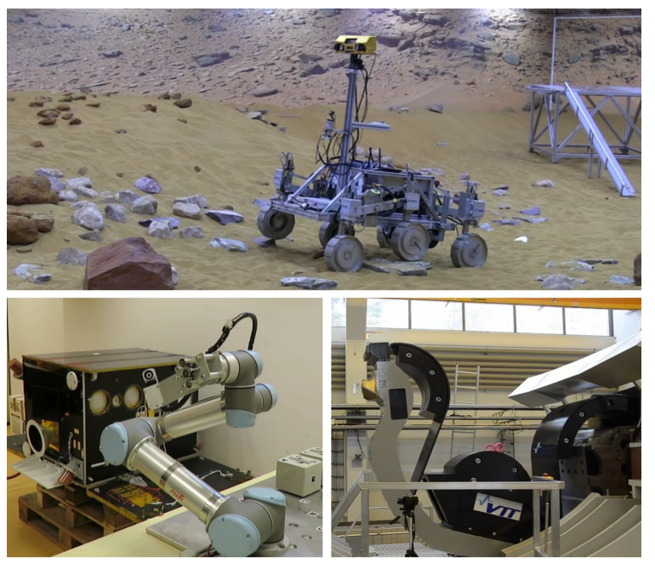
USE CASES
Results

Slide 25
GR740 WITH
COMRADE

Slide 26
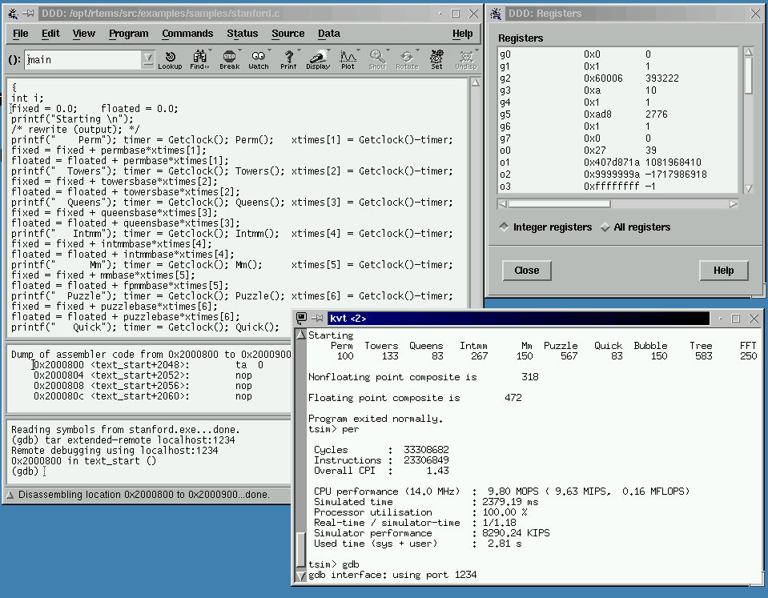

Better SIL to PIL Transition
OBJECTIVES
  Upgraded SIL simulator to address critical aspects in early phases.
    GNC software.
    LEON4 processor.
  Include a software emulator of the target processor that lead significant improvements over SIL, yet simpler than PIL.
  Resulting V&V chain.
    MIL → Automatic Coding → SIL x86 → SIL SPARC/LEON4 → PIL → HIL

Slide 27
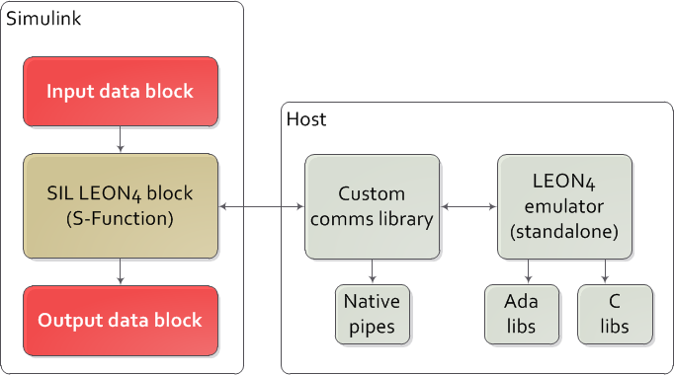
Improved LEON4 Processor Emulator
Results
  ESOC Emulator Suite (ESOC EMU) selected for providing software emulation functionality with GMV’s LEON4 emulator from ESA HAIR project has been ported and enhanced for this activity.
  Designed to run a standalone process, launched from S-Function block.
  Software executed directly from code generated from Simulink.
  Pipes communications library with a client/server architecture also developed as part of this activity.

Slide 28
Validation and Performance
CONCLUSIONS
  Inexpensive validation with representative tools, i.e., processor emulator, is beneficial for early error discovery.
  Development of SIL representative simulators in COMRADE has proven beneficial to assess the generated code early, and to mitigate risks during the ongoing PIL and HIL test campaigns.
Simulator | Base Frequency | Min. / Max. cycle count | Avg. Processor Free | WC Processor Free
eDeorbit Synchronisation | 30 Hz | 6062 / 1760962 | 94.34801715 % | 78.868456 %
eDeorbit Stabilisation | 30 Hz | 18755 / 2808688 | 86.2383149 % | 66.295744 %
ASSIST Synchronisation | 30 Hz | 6062 / 1605304 | 94.03503456 % | 80.736352 %
Notes:
In summary, this upgraded SIL simulator is an affordable tool to mitigate risks and early performance assessment.

Slide 29
Conclusion
MORA-TSP

Slide 30





END TO END DEMONSTRATION
OBJECTIVES
  ESA Invitation to Tender AO/1-8834/17/NL/FE:
  “Multicore Implementation Of The On-Board Software Reference Architecture with TSP Capability”
  Multicore Implementation of the OBSW Reference Architecture with Time and Space Partioning
  Duration: 14 months
  Consortium:

Slide 31
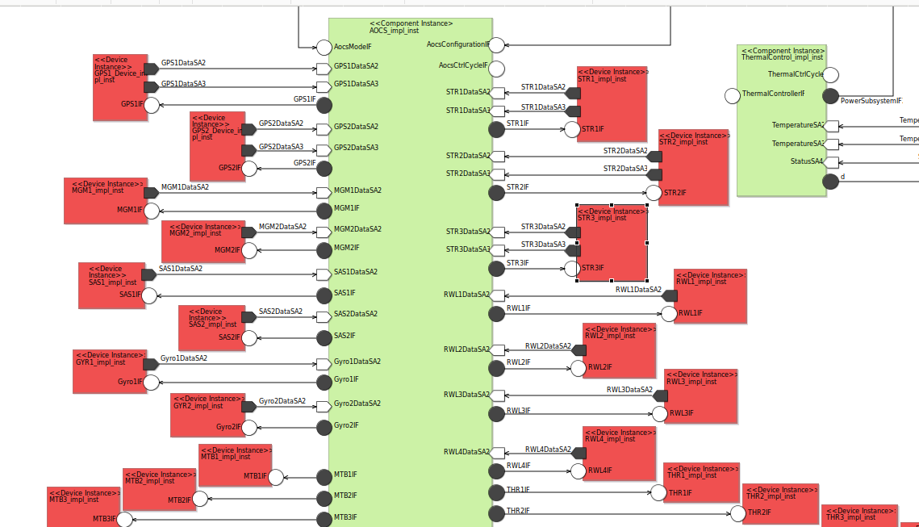
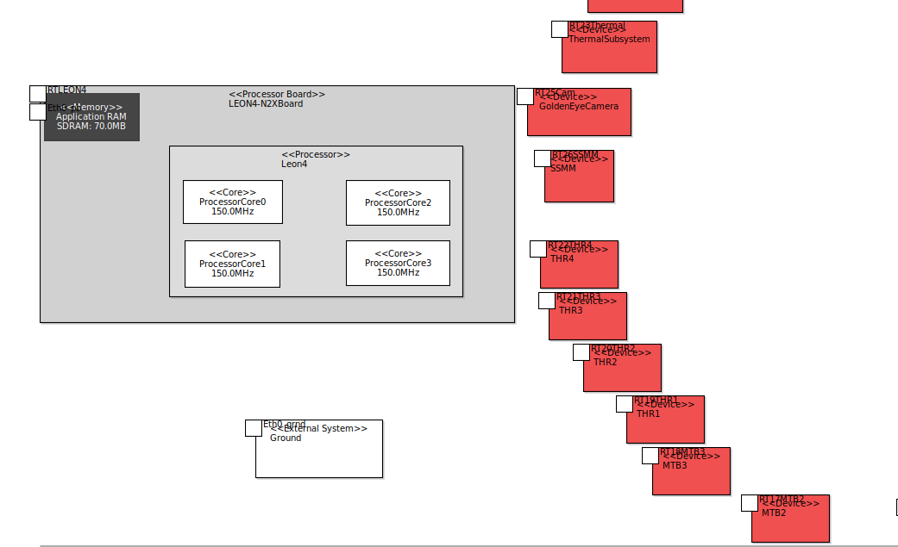
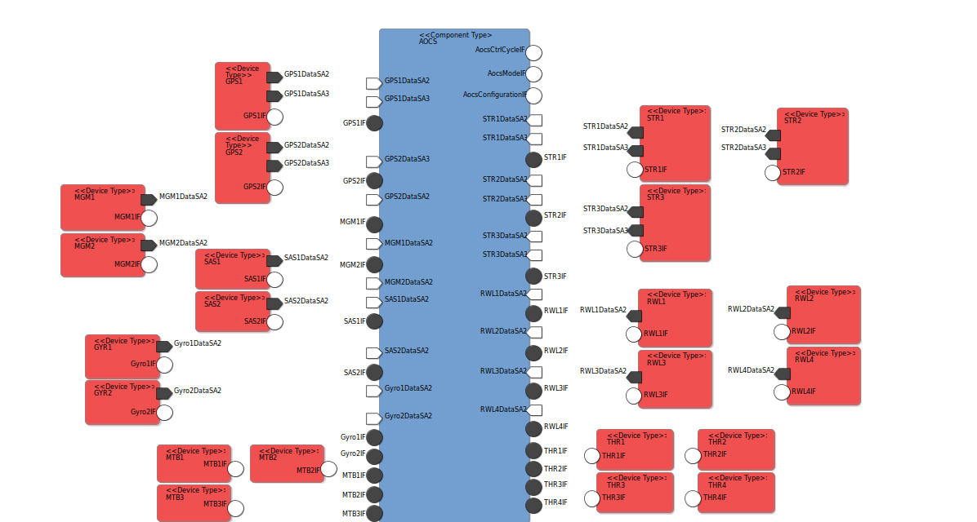
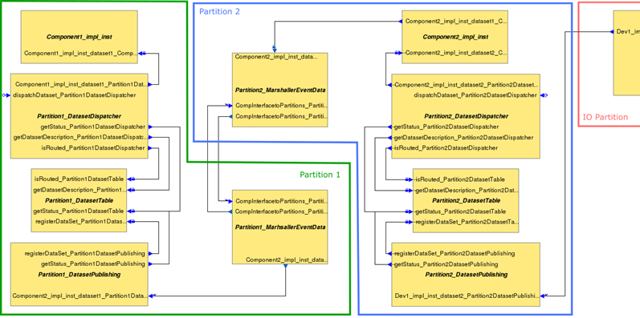
EAGLEEYE USE CASE MODEL
RESULTS

Slide 32
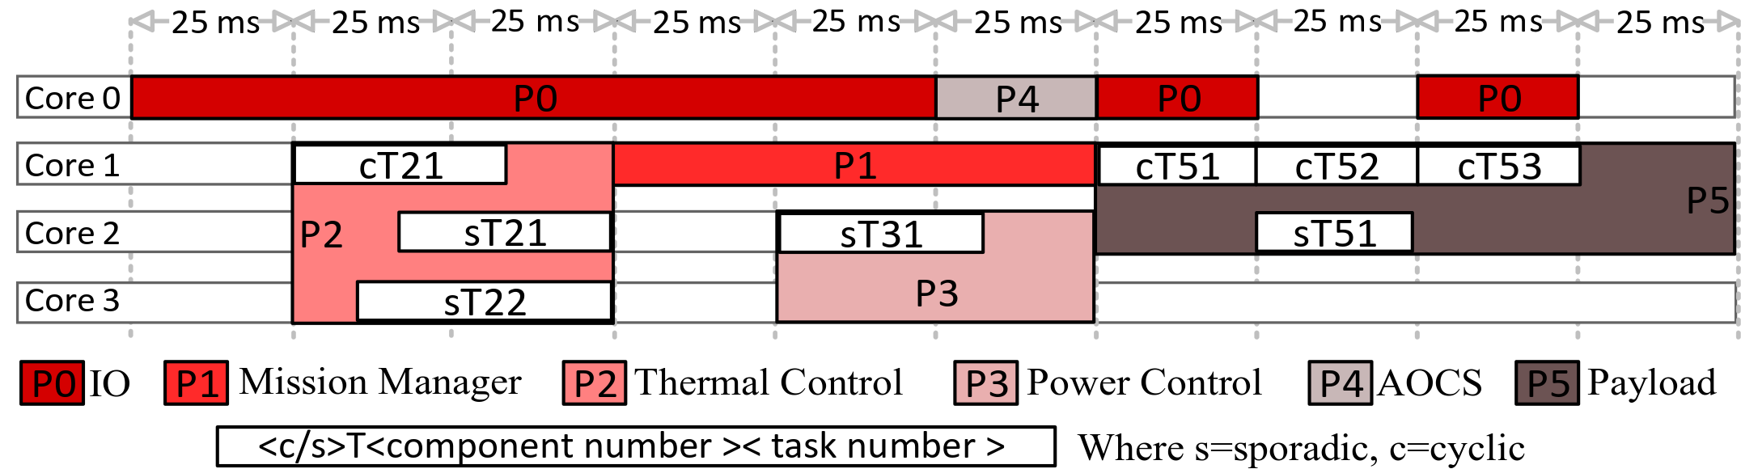
Current Results
EagleEye
TASTE has been upgrade to have AIR integrated and provide binaries running in TSP and SMP multicore.
Several EagleEye scheduling scenario have been drawn including partitions running in multiple cores with RTEMS 5 SMP.
Page 32

Slide 33








www.gmv.com
THANK YOU
daniel.silveira@gmv.com
lasg@gmv.com

