Slide 1
Extrae: an OpenMP-compatible performance monitoring tool for the GR740
GR740 User Day
Franck WARTEL (Airbus Defence and Space)
Eduardo Quiñones (Barcelona Supercomputing Center)
28 Nov. 2019

Slide 2
Agenda
  A quick introduction to HP4S project (ITI)
  Extrae tool ported to GR740

Slide 3
High Performance Payload Processing Requirements
  High demand for flexibility in High Performance Payload Processing
    ASIC < FPGA < Processors (General Purpose Processors)
    Many future processing devices are multi or many cores
    parallel processing on-board on multi/many cores for image, new sensors, radar, telecom, robotic, Vision Based Navigation use cases
  Airbus DS is working on future high performance space computer (multi-core), both radiation hard and radiation tolerant (New Space approach)
    Software parallelization needs methodologic and tooling support for more efficiency
    and this can get some momentum from the innovation and academic works in this area
  Need for the parallelization to be rather independent w.r.t. the specific characteristic of the target device
    Portability: The application may be developed without a deep knowledge of the platform.
    It is the runtime which is adapting the parallelization to the target device.
    Can be used both on Rad-Hard and Rad-Soft (COTS) devices

Slide 4
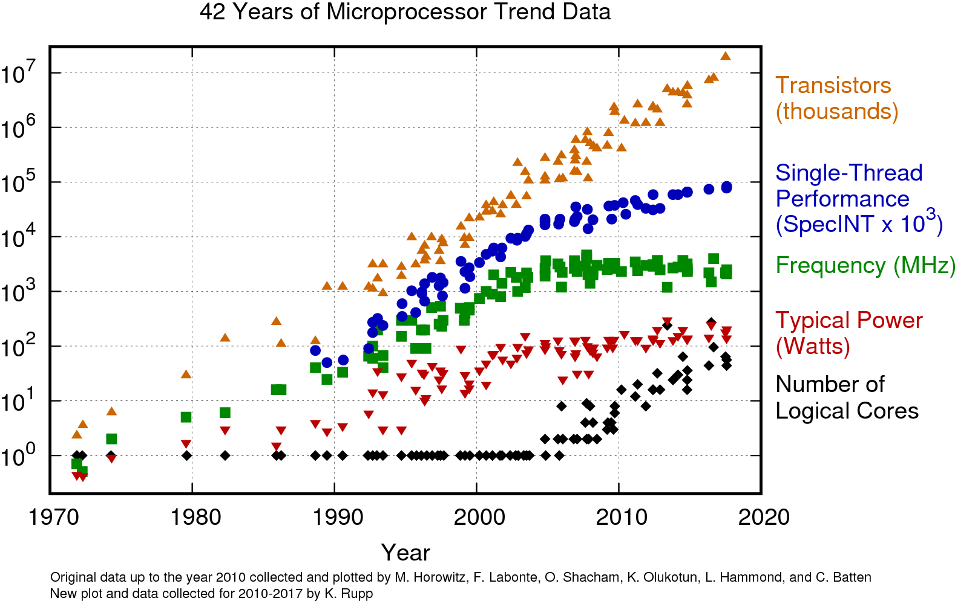
General Purpose Processors Trend

Slide 5
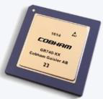

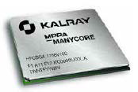
High Performance Parallel Payload Processing for Space (HP4S) with OpenMP
HW Selection
SW Case selection
HRGEO
Active Mirror
Disparity map
Inverse Kinematic
SW Benchmarks selection
Tailored ESA NGDSP
benchmark
BOTS
GR740
MPPAv3
« Coolidge »

Slide 6
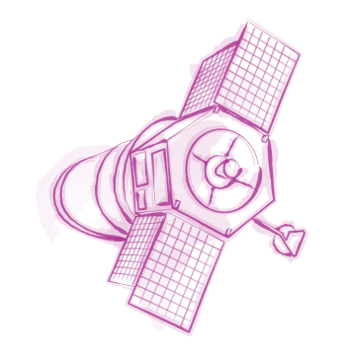


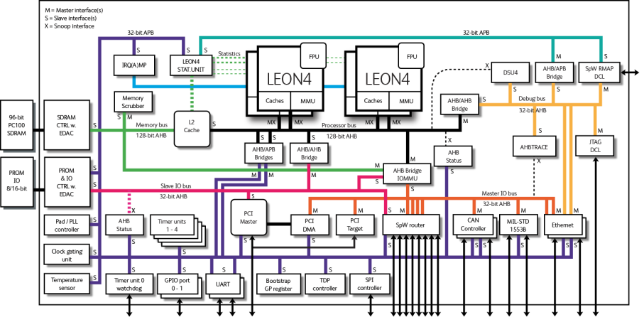
Hardware and Software Stack
+
sparc-gaisler-rtems5-gcc
(Cobham Gaisler RCC 1.3-rc6) 7.2.0
sparc-linux-gcc
(Cobham Gaisler Linux 4.9 Toolchain 1.0) 4.9.4

Slide 7
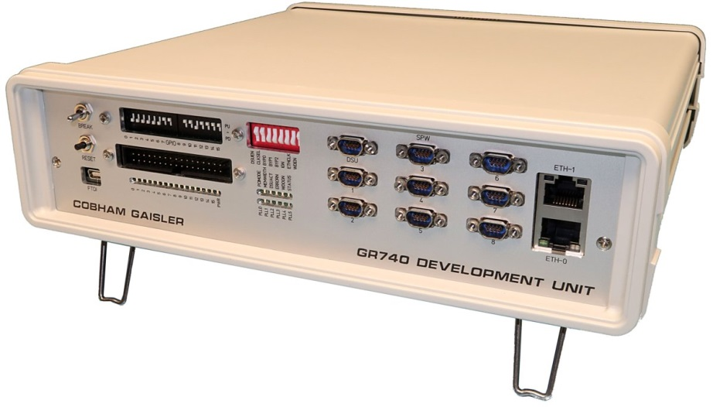

Lab Setup
Ethernet Gigabit
with NFS support
ftdi usb for grmon
Embedded
SMP OS
OpenMP runtime
NFS client for I/Os
Use Case application
Extrae instrumentation lib (for observability)
Gnd Dev
OpenMP compliant SDE
NFS server for I/Os
GRMON for upload/exec/serial
Paraver BSC visualization tool

Slide 8

HRGEO algorithm overview
Goal is to improve the S/N ratio on a static image by merging multiple images from a stream captured by a more or less steady camera (translation/rotation)
The algorithm includes image registration, resampling and fusion
The algorithm creates and manages a geometric model fitting image displacement, then accumulates successive images into a single reference image after compensating for the displacement with a sub-pixel accuracy

Slide 9
Why OpenMP?
Mature language constantly reviewed (last release Nov 2018, v5.0)
  Defacto industrial standard in HPC shared memory (and heterogeneous) processor architectures
  Active research community
Productivity in parallel programming
  Performance
    Fine-grain data/task-parallelism and an advanced accelerator model for heterogeneous computing
  Portability
    Supported by many chip vendors (Intel, IBM, ARM, NVIDIA, TI, Gaisler, Kalray)
  Programmability
    Interoperability with other programming models (e.g., MPI, CUDA)
    Currently available for C, C++, Fortran and Ada (under evaluation)
    Allows incremental parallelization (#pragma omp) that can be easily compiled sequentially
Increasing interest on the embedded computing domain

Slide 10
Paralleling the HRGEO on the GR740
A new parallel region is created
Data Parallelism
Task Parallelism
#pragma omp parallel
#pragma omp single
{
…
#pragma omp for
for(i=0;i<N;i++)
for(j=0;j<M;j++)
…
}
#pragma omp parallel
#pragma omp single
{
…
#pragma omp task depend (in:A, out:B)
correlation_func();
#pragma omp task depend (in:B, out:C)
resampling_func();
…
}
For loop iterations are executed in parallel
Asynchronous parallel execution with fine-grain synchronization

Slide 11
Analyzing the parallel version of HRGEO on the GR740
Typical practise on performance analysis
Data Parallelism
#pragma omp parallel
#pragma omp single
{
…
#pragma omp for
for(i=0;i<N;i++)
for(j=0;j<M;j++)
…
}
No information about
The parallel execution efficiency from a programming perspective
Usage of computing resources

Slide 12
Categories of performance analysis tools
Based on how data is collected
Based on how data is stored
Instrumentation:
  Captures information based on events
  Requires modification of the application manual or automatic
  Reports exact data
Sampling:
  Captures information periodically
  Does not require modifying the application
  Reports relative data
Tracing:
  Stores information in a timeline basis
  Holds exact data
  A profile can be derived from the trace
Profiling:
  Stores information in counters
  Holds summarized data
  A trace cannot be derived from a profile
Extrae

Slide 13
Extrae¹: an HPC tracing tool
A dynamic instrumentation package to trace parallel programs
Capable of automatically capturing the activity of the parallel runtimes
  No need to access the source code, recompiling, relinking, or having prior knowledge of application internals structure
Allows reasoning about the execution behaviour of the parallel programing model
  OpenMP support (other supported programming models are MPI, pthread, etc.)
… But not supported in the GR740…
¹ Extrae means Extract in spanish

Slide 14
Extrae on the GR740¹: Modification needed
Static compilation of Extrae with the application
Intercepting calls in a static system by using the --wrap linker flag
Retrieving function names using the binutils library
Trace generation for storing all the events gathered during the execution with minimum interference with the execution based of NFS
Support of GR740 hardware counters (L4STAT driver)
  Cache miss, MMU TLB miss, Cache hold, MMU hold
  Total/Integer/FP instruction count
  AHB utilization (per AHB master/total)
  Etc.
¹Available at https://github.com/bsc-performance-tools/extrae/tree/gr740

Slide 15

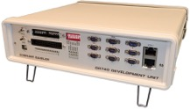

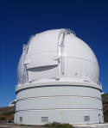
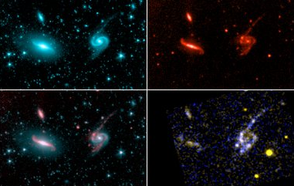
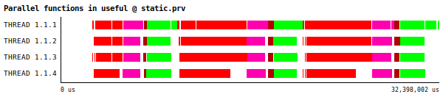
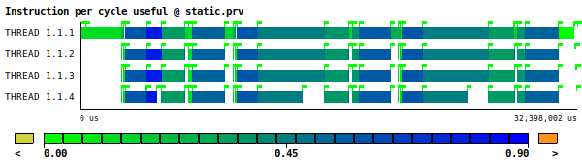
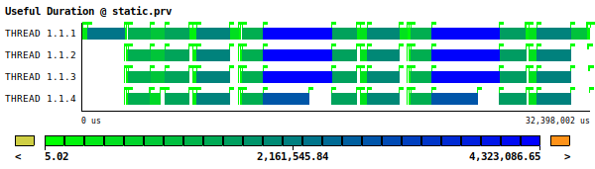
A Multispectal Imaging of the Parallel Execution
HRGEO
+
Reality
Tools for observing the reality
Extrae
Sequence of time-stamped events (trace)
Different representations of the same reality containing different information

Slide 16
Paraver¹: A “multispectral philosophy” browser to manipulate Extrae traces
Eg., parallel functions view
(Parallel programming level)
Core 1
Core 2
Core 3
Core 4
correlation
resampling
fusion
stabilization
#pragma omp for
Eg., “Useful” computation execution time
(Application’s internal structure level)
Core 1
Core 2
Core 3
Core 4
Eg., Hardware counters information view
(computing resources usage level)
Core 1
Core 2
Core 3
Core 4
¹ Paraver means for seeing in spanish
https://tools.bsc.es/paraver

Slide 17
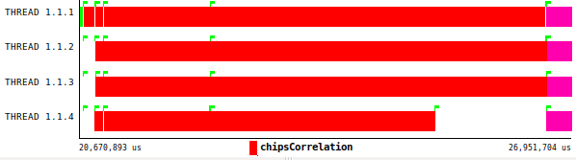
Analyzing the parallel execution with Extrae+Paraver
Eg., parallel functions view
(Parallel programming level)
Core 1
Core 2
Core 3
Core 4
correlation
resampling
fusion
stabilization
#pragma omp for
for(i=0;i<N;i++)
for(j=0;j<M;j++)
Core 1
Core 2
Core 3
Core 4
#pragma omp for schedule(guided) \\
collapse(2)
for(i=0;i<N;i++)
for(j=0;j<M;j++)
The parallel execution of for loops is unbalanced

Slide 18
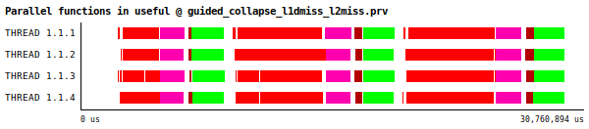
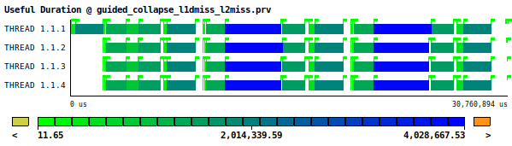
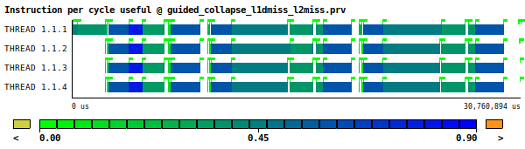
Analyzing the parallel execution with Extrae+Paraver
#pragma omp for schedule(guided) \\
collapse(2)
for(i=0;i<N;i++)
for(j=0;j<M;j++)
Core 1
Core 2
Core 3
Core 4
correlation
resampling
fusion
stabilization
Core 1
Core 2
Core 3
Core 4
0.45
Core 1
Core 2
Core 3
Core 4
Check L1 and L2 miss rate views,
data cache hold views, etc.

Slide 19
Conclusions
The goal of the HP4S project is to demonstrate the benefits of OpenMP to develop parallel payload processing for space
The use of analysis tools is of paramount importance to exploit the performance capabilities of parallel architectures (GR740)
  An efficient parallel programming
  An efficient resource usage
We presented an OpenMP performance analysis tool used in HPC
  Extrae¹, an instrumentation tool to trace parallel programs, based on an automatic capture of of the parallel runtimes activity
  Paraver², a “multispectral” browser to manipulate Extrae traces
¹https://github.com/bsc-performance-tools/extrae/tree/gr740
²https://tools.bsc.es/paraver
{eduardo.quinones@bsc.es}

Slide 20

Thank you

